Slide 1
Market Based Mechanism for Climate Change Mitigation in Indonesia
Indonesia JCM Secretariat

Slide 2
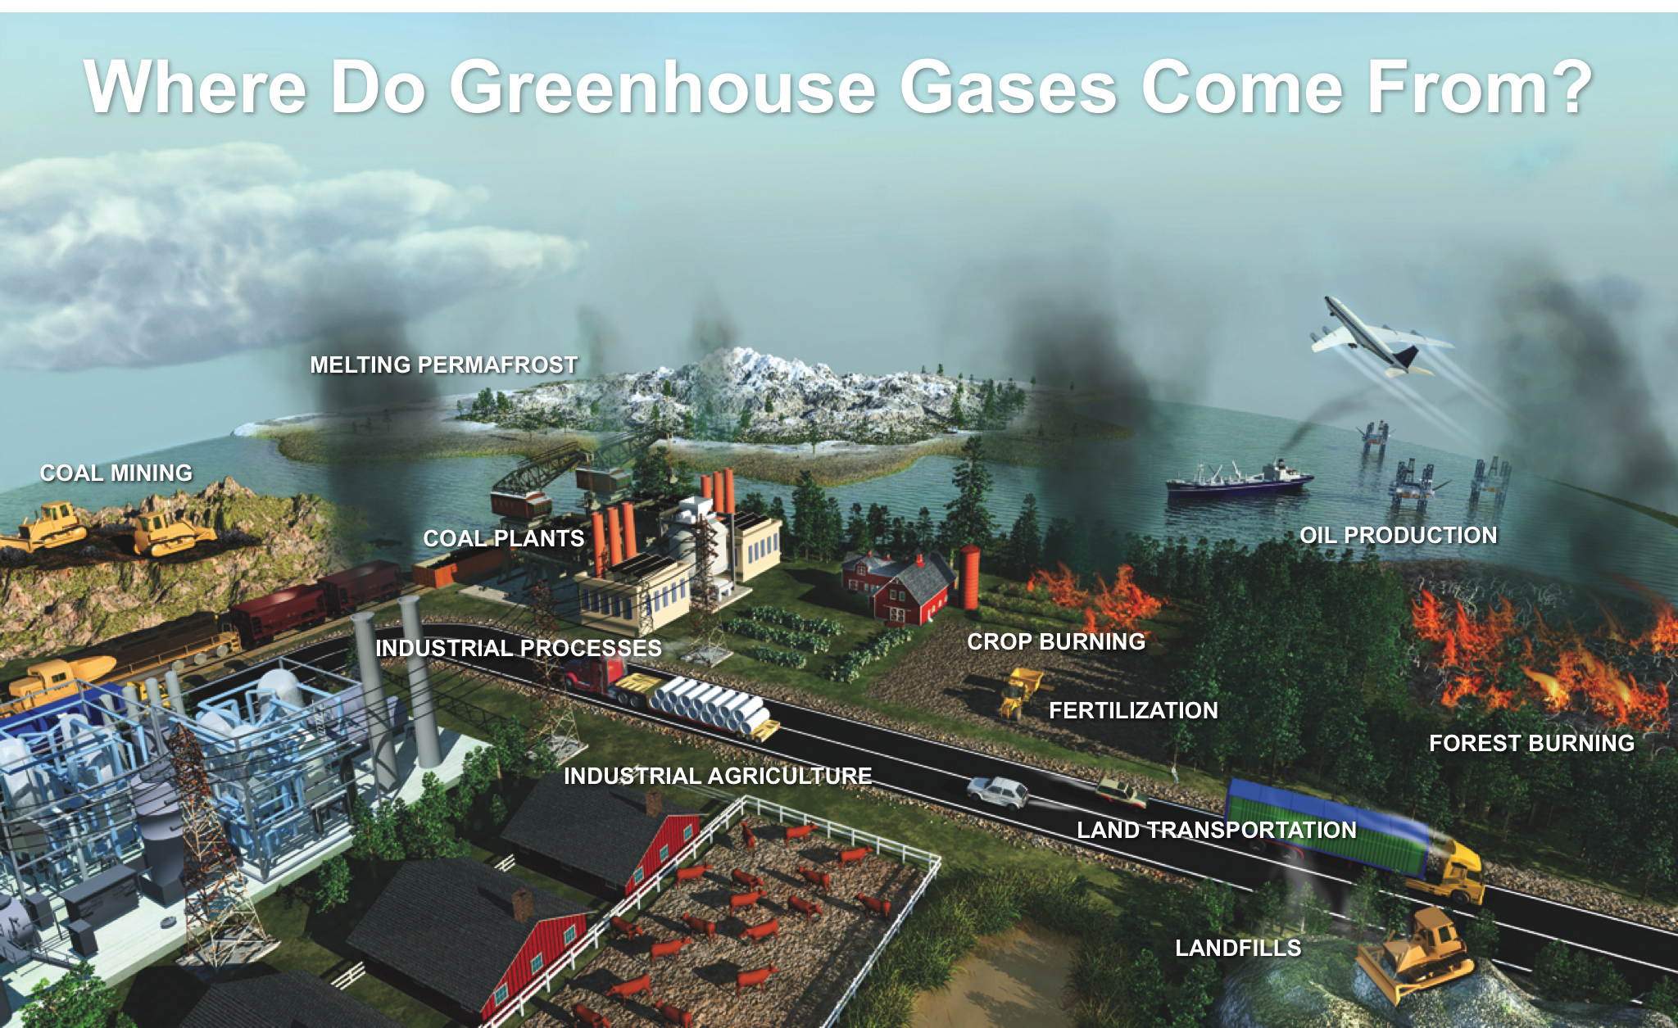

Slide 3
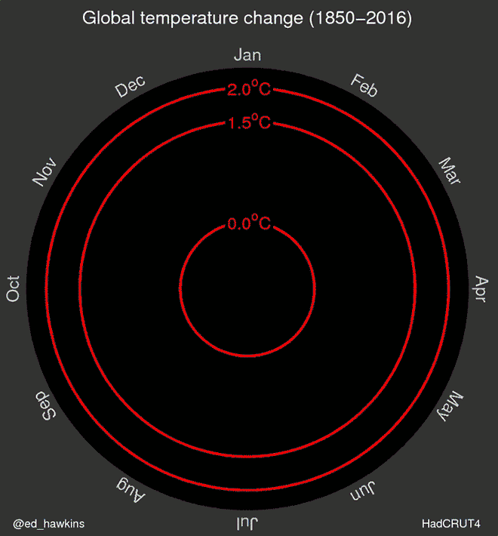
Monthly global temperature data

Slide 4




No question why we need to reduce the emission
Green House Gases
Emission
Green House Effect
50°C
Global Warming
Climate Change
Disaster Risks

Slide 5
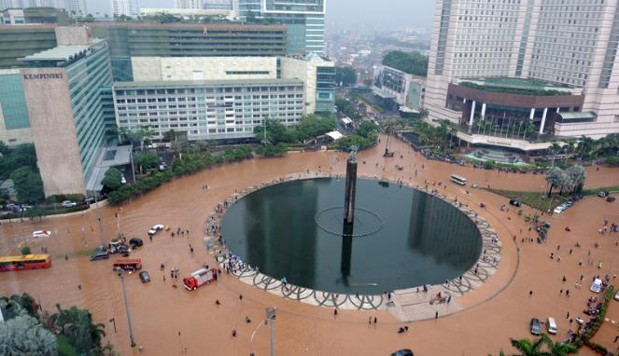

Slide 6
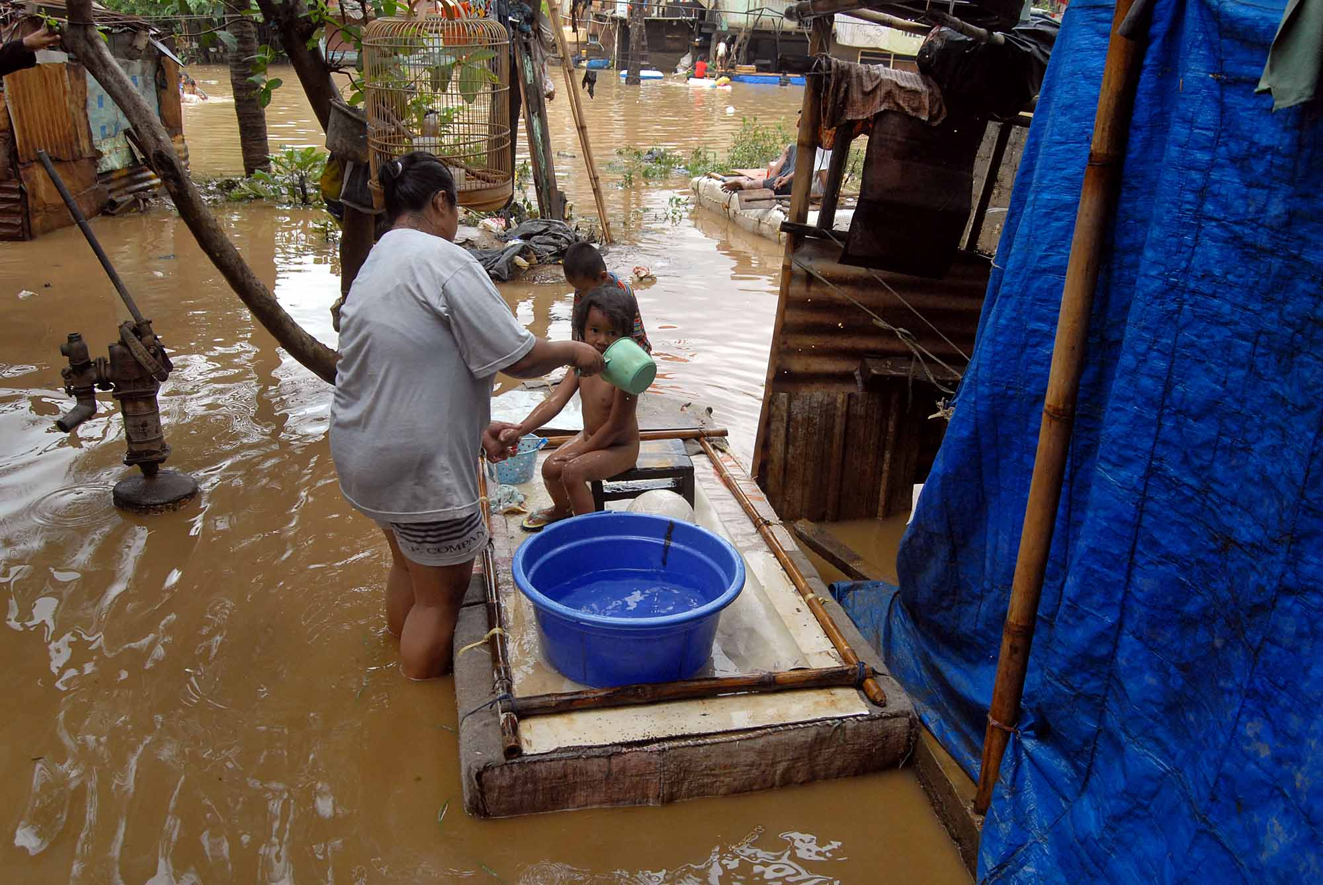

Slide 7
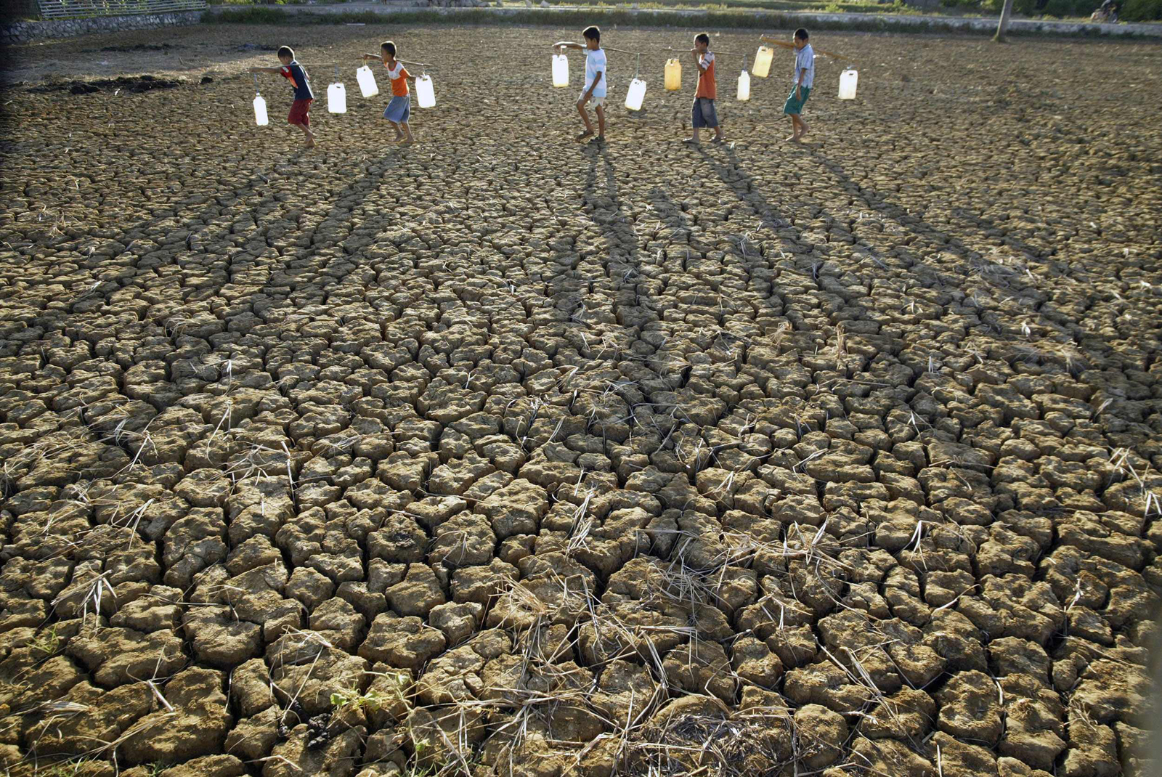

Slide 8
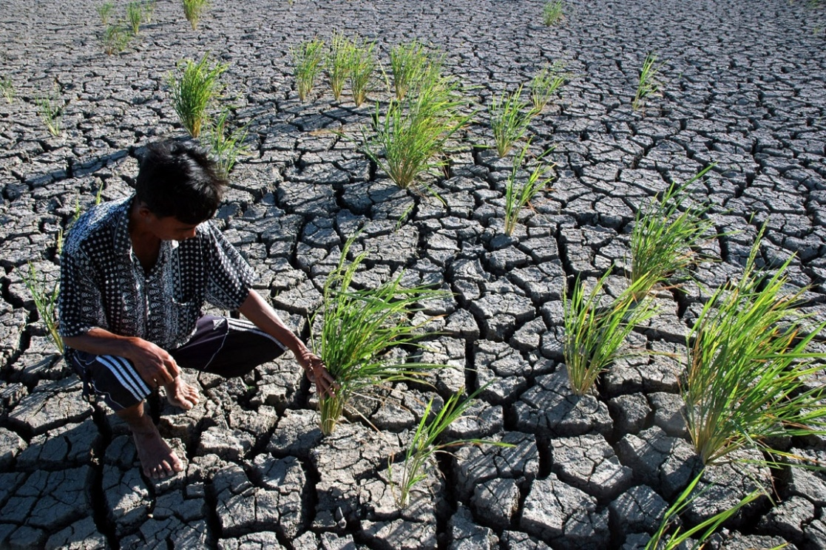

Slide 9


Slide 10
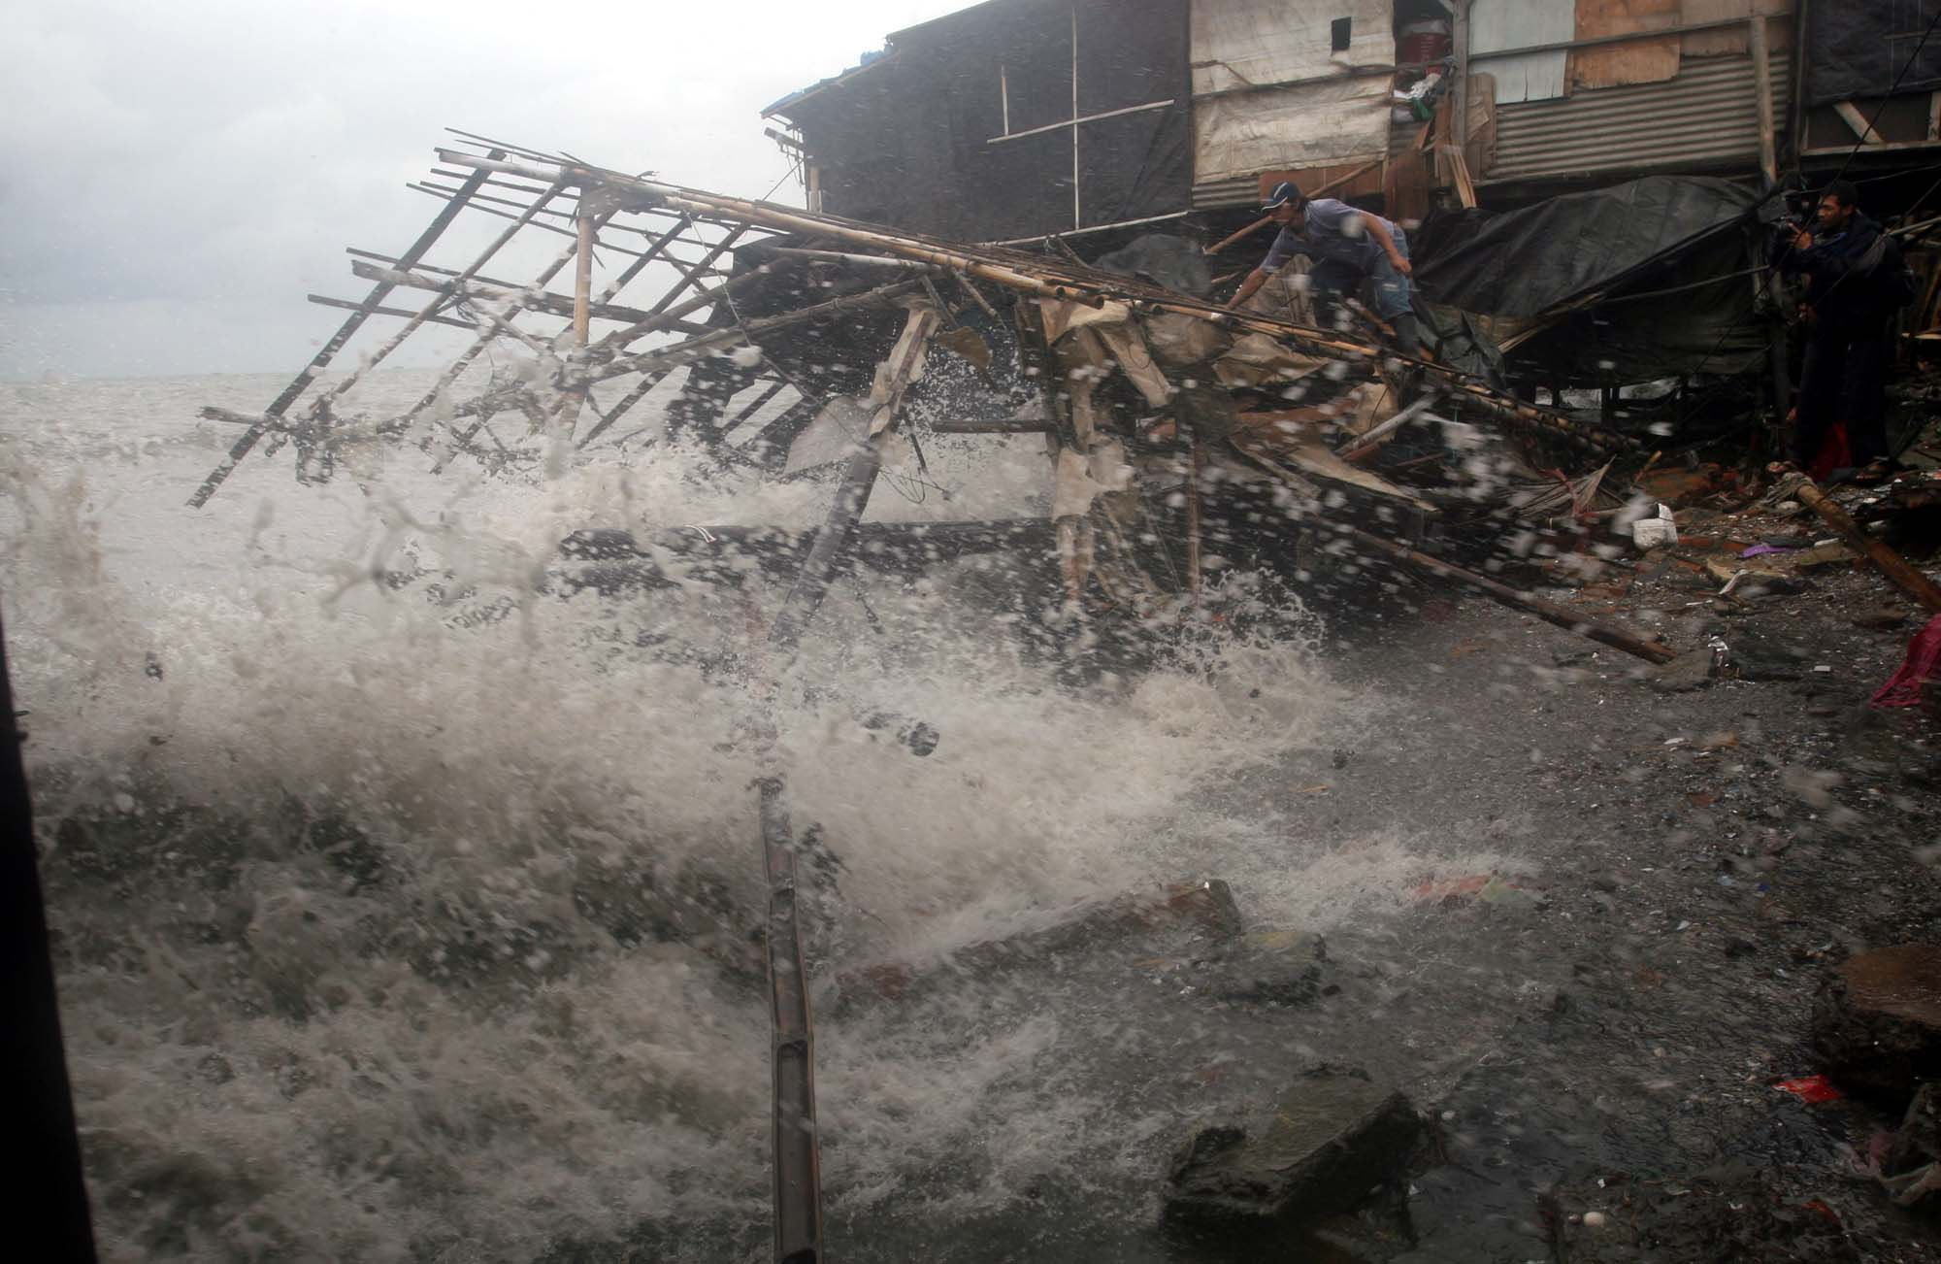

Slide 11

What happened in COP 21 Paris?
Parties of the UNFCCC pledged to curb its carbon emission, strengthen resilience and joined to take common climate action.
Paris Deal includes a temperature limit of “well below 2 C” and says there should be “efforts” to limit it to 1.5 C. To do so requires 32 GtCO₂e emission to be cut in 2050, and around US$ 40 trillion additional investment to transition to a global low-carbon economy.
To achieve long-term temperature goal or in another word reaching net zero-emission after 2050.
Legal obligation on developed countries to continue to provide climate finance to developing countries.
On mitigation, binds parties to prepare and regularly update climate commitments and developing countries are encouraged to move towards stricter goals.

Slide 12
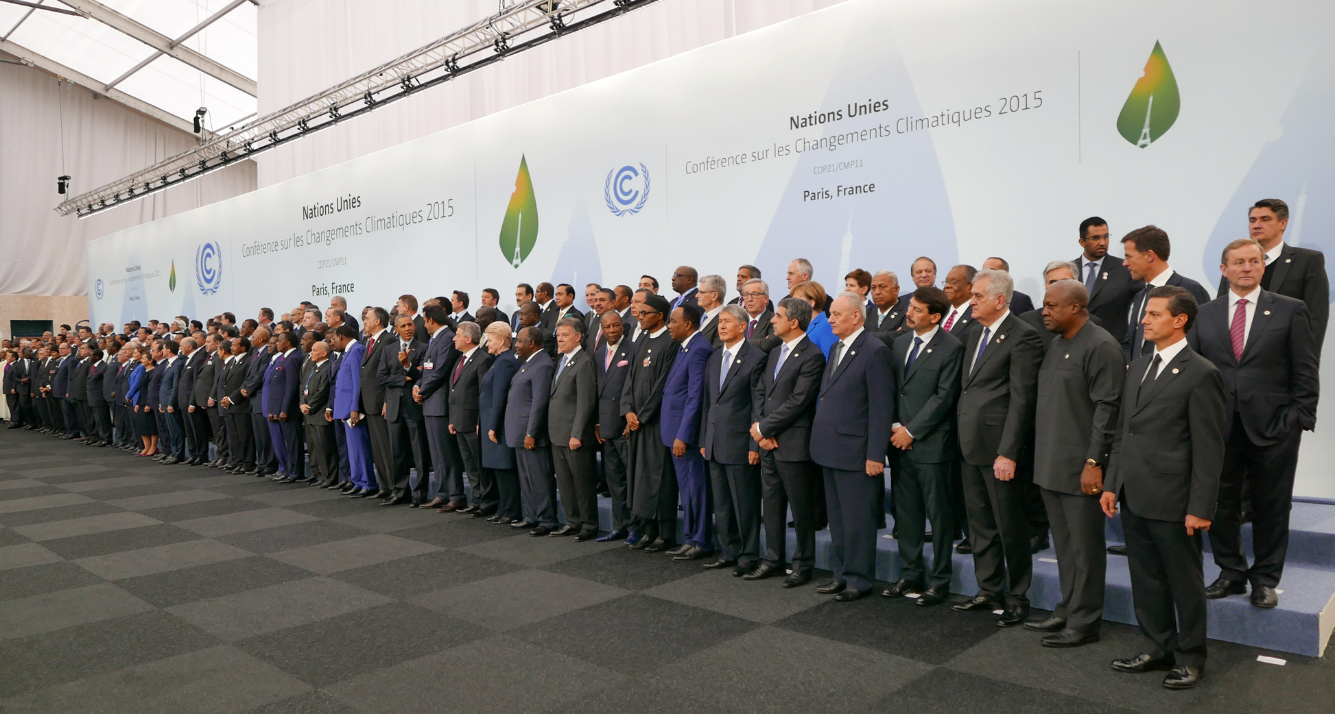
Global problem need global commitment
195 countries agreed on Paris Agreement

Slide 13
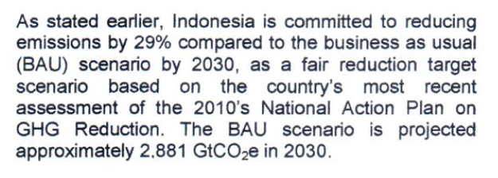

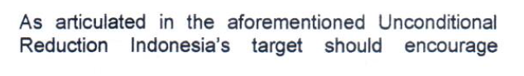
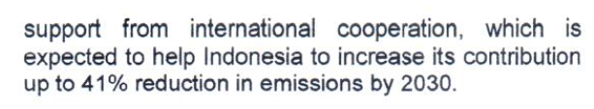
Indonesia and every country must contribute the emission reduction
Intended Nationally Determined Contribution (INDC)
UNCONDITIONALITIES
CONDITIONALITIES:

Slide 14
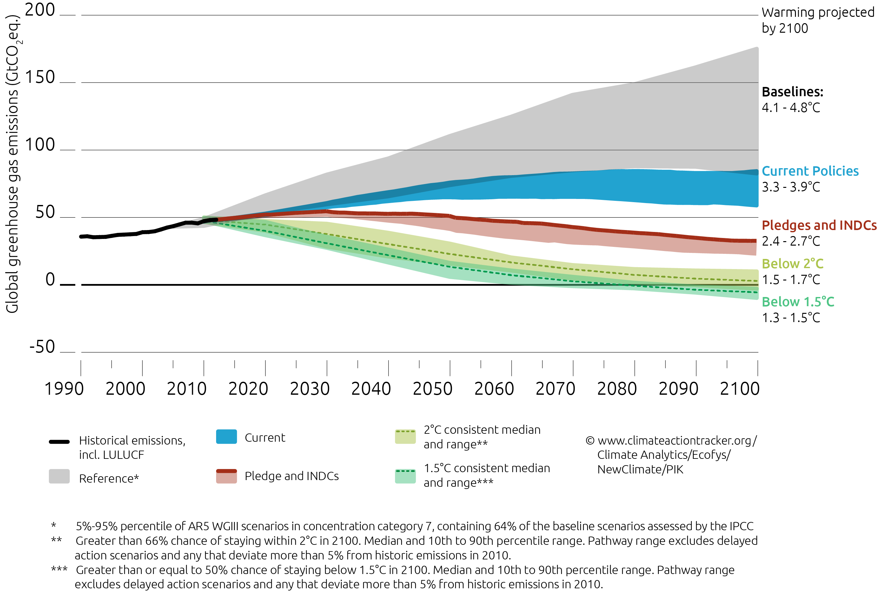
Global INDC aggregate
Including all of countries pledges
Source: climate action tracker

Slide 15
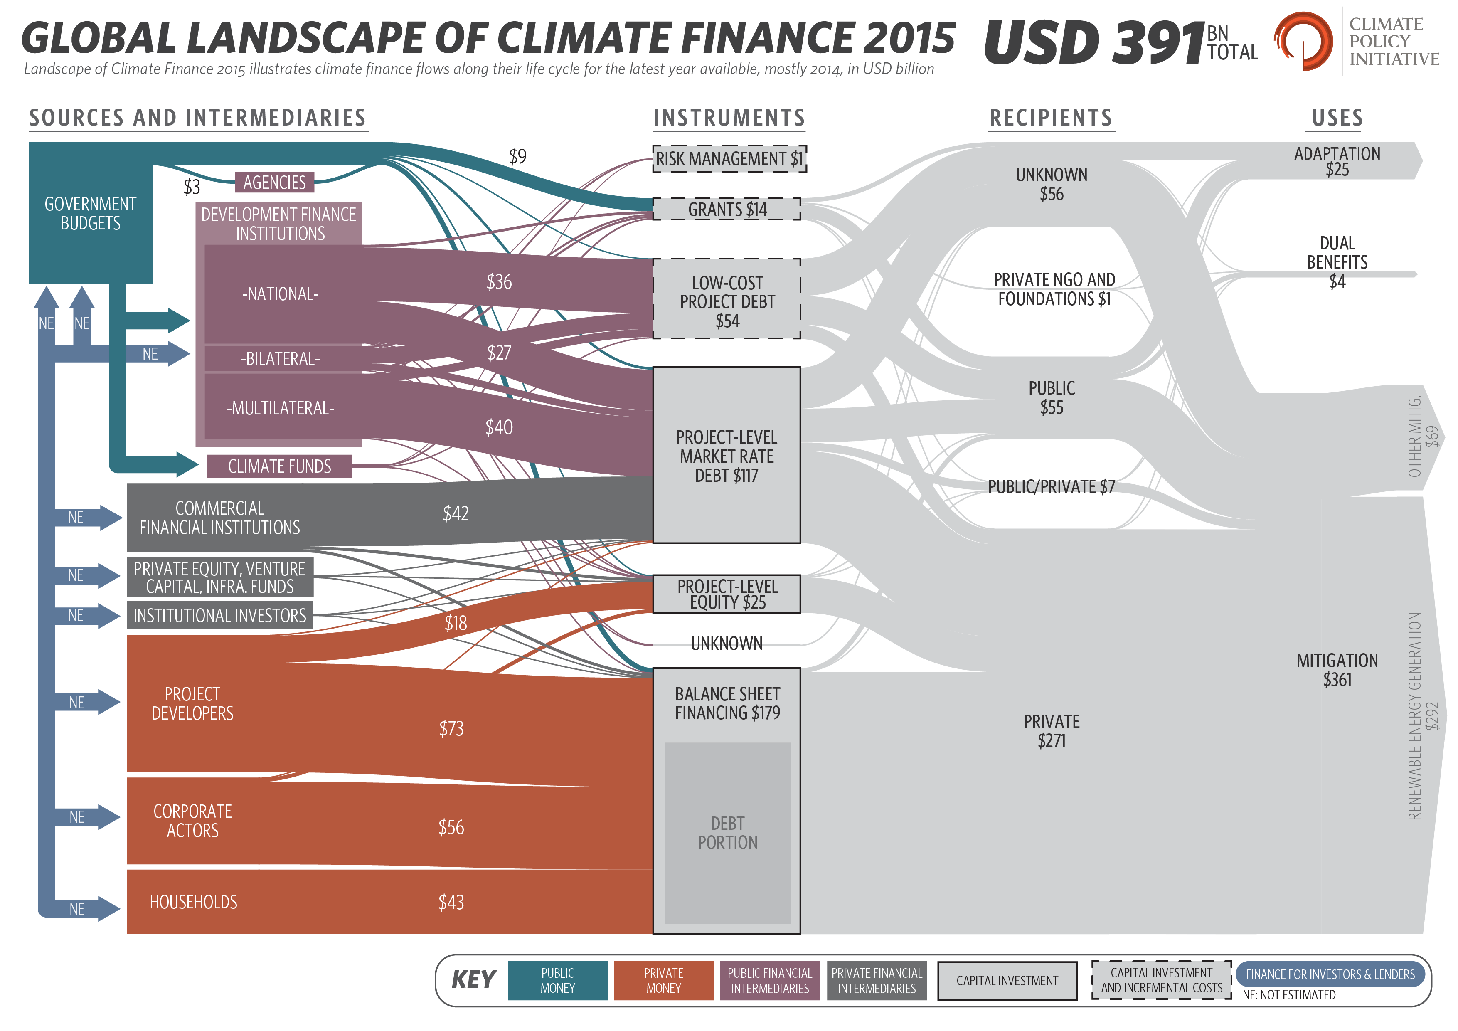
Combatting climate change = money!

Slide 16
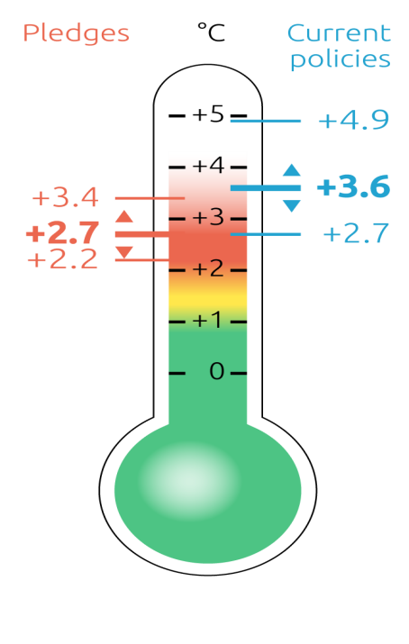

We need market based mechanism for climate change financing mitigation
Government budget will not enough to combat the climate change!
Market-based mechanism (MBM) is policy mechanisms that use market, price, and other economic variables to provide incentives for polluters to reduce or eliminate negative environmental externalities.
Market based mechanisms, if designed well, are widely seen as an effective tool for reducing greenhouse gases (GHGs) and fostering energy efficiency and renewable energy as well as developing sustainable forestry.
Some of the well known MBM types are emission trading scheme (ETS), carbon taxes, crediting mechanism, and certificates of renewable and energy efficiencies.
The measures itself is a MRV (measurement, reporting, and verification) system that developed based on transparency and accountability principles.
Through MBM, the government can enhance the involvement of private sectors in climate change mitigation actions.
Source: climate action tracker

Slide 17
So, we put a price on a carbon
National Target
Source of Revenue
Product and Process Efficiency
Scaling Up Private Sector Fund
Putting a price on a carbon will make the calculation and planning easier.
Putting the price on a carbon will generate revenue and business opportunity that can be used to implement low carbon technologies.
As the emission will become cost, companies will be triggered to be more efficient in the production process
The private sector will be interested to invest in the low-carbon development as there is incentive for reducing emission
Trigger Behavior Change
By putting price on a carbon it is likely the price of energy will get higher, thus changing behavior of the people to be more efficient (demand side management)
Every country must reduce the emission based on their own target.

Slide 18
A ton is a ton!
Basic principles of market based mechanism is:
a ton is a ton!
It means that any emission reduction activities in any part of the world gave the same effect to atmosphere if we do it in the same amount!
Baseline emission
Emission units
in ton CO2
Projected emission
reduction
To change activity unit (kWh, kg, liter, etc) to ton CO2 we use emission factor
Emission = activity unit x emission factor
Emission factor is average emission rate of a given GHG for a given source, relative to units of activity (UNFCCC)

Slide 19
Market based mechanism instruments map

Slide 20
Coverage of the global GHG emission

Slide 21
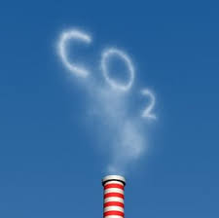
Market based mechanism types
Clean development Mechanism (CDM)
Joint Implementation
Emission Trading Scheme (ETS)
Crediting scheme (VCS, JCM, plan vivo, CCB)
Carbon tax

Slide 22



To calculate the emission we use MRV
M is measurement
R is reporting
V is verification
Some basic elements of MRV
Scope of MRV (and governance)
Methodology and baseline
Measurement system (qualitative and quantitative)
Reporting
Verification (and third party entities)
Registry and issuance system.
Scale
National
Sub-national / Scheme
Project / Activity level
M
R
V

Slide 23

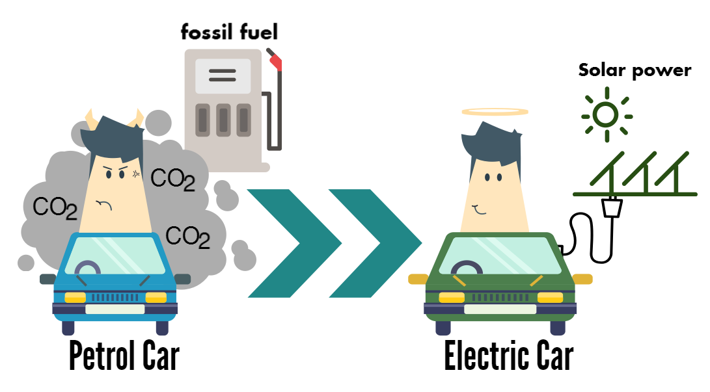
How crediting work
Emission reduction is the difference between emission scenario without project with the actual emission after the project is being implemented.
In crediting, each 1 ton of CO₂ emission reduction is equivalent to 1 carbon credit
To quantify emission reduction, methodology is needed.
Emission before project
Carbon credit
CO₂
Emission after project
CO₂
before project
after project

Slide 24
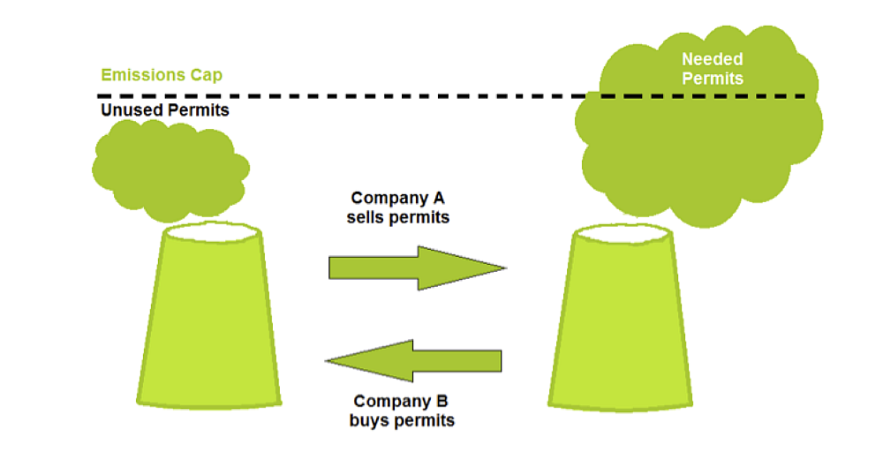
How cap and trade/ETS mechanism work
By applying cap and trade policy, quantifiable emission reductions can be delivered by setting a cap.
Emissions trading or cap and trade is a government-mandated, market-based approach to controlling emission by providing economic incentives for achieving reductions in the emissions of pollutants

Slide 25
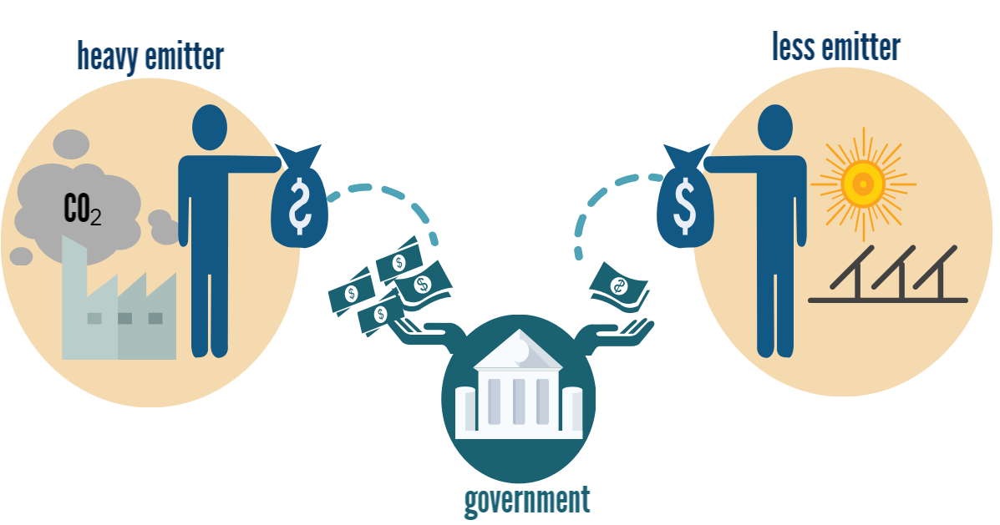
What is carbon tax?
Carbon tax is a form of explicit carbon pricing; it refers to a tax directly linked to the level of CO₂ emissions, often expressed as a value per tCO₂ equivalent¹
With carbon tax, a ton of emitted GHG has a price according to the taxation policy. Thus, creating incentives for emitters to shift to less GHG intensive ways of production and resulting in reduced emission.
¹ based on “Climate carbon – Aligning prices and policies,’ OECS Environment Policy Paper, October 2013 nº01

Slide 26
Carbon market
A carbon market is a market that is created from the trading of carbon emission allowances or credits to encourage or help countries and companies to limit their carbon dioxide (CO2) emissions.
Carbon market elements:
Policy
Setting environmental target goal
Selecting appropriate policy instruments
Sharing possible carbon revenues
Policies to encourage pilot
Technical
Coverage
MRV system
Reference/baseline scenario
Registry and transaction log
Institutional and legal
Issuance system
Institutional for the verificatory
Rules and regulation
Why carbon market?
Seller
Profit
Green incentives
Co benefit
Buyer
Obligation to reduce emission
Cheaper and easier
Guaranteed quality
Voluntary
Cost Effective

Slide 27
Carbon pricing instrument statistic
Jurisdiction
39 National
23 Sub-national
Instrument
38 carbon pricing instruments (already implemented or scheduled for implementation)
90% increased compare to 1st January 2012
Coverage
Around 12% of the global emission or 7 GtCO₂e
ETS consists of 8% & carbon tax consists of 4%
Price
Ranging from US$ 1 – 130 /tCO₂e

Slide 28
List of countries implementing carbon pricing instruments
ETS
National:
Liechtenstein, Austria, Belgium, Bulgaria, Croatia, Cyprus, Czech Republic, Germany, Greece, Hungary, Lithuania, Italy, Luxembourg, Malta, The Netherlands, Romania, Slovakia, Spain, Kazakhstan, Korea, Taiwan
Sub-national:
RGGI, Tokyo, Saitama, Kyoto, California, Quebec, Shenzhen, Guangdong, Shanghai, Beijing, Tianjin, Hubei, Chongqing
Carbon Tax
National:
Japan, Mexico, Chile, South Africa, Costa Rica
Sub-National:
British Columbia, Alberta
ETS and Carbon Tax
Iceland, Norway, Denmark, Estonia, Finland, France, Ireland, Latvia, Poland, Portugal, Slovenia, Sweden, United Kingdom
The classification is excluded other policy instruments such as: removal of fossil-fuel subsidies, infrastructure investment in transport and energy, renewable energy portfolio standard, and energy efficiency standard

Slide 29
Current market based mechanisms in Indonesia
CDM
Overly high expectation
Difficult and complex to be implemented
Ceased due to the lack of demands
Currently no CDM project developed
Unbalance/unfair credits allocation as all the credits goes to the buyer
VCS
Smaller scale than CDM.
Indonesia has the biggest REDD+ project and it is until now the only land based project of VCS in Indonesia.
Several projects was conversion from CDM, due to the lack of CER demand.
Other Voluntary Scheme
Plan Vivo is one of the voluntary scheme that developed in Indonesia..
The projects are relatively small and usually for social forest projects.
Climate, Community and Biodiversity Standard (CCBS) and Gold Standard are also used to “wrapped” the carbon projects.
Indonesia
INDC
Market and
non market approaches
The JCM Scheme
The Joint Crediting Mechanism currently is the most progressive market based mechanism and climate change mitigation activities in Indonesia and in the world.
It is not only about the bilateral carbon trading, but rather how to develop and implement the green investment as well as low emission development and technology transfer between the 2 countries.
Japan and Indonesia have their own national target on emission reduction and it can be done through JCM through sharing of the emission credit.
Both countries are required to increase their economic development as well as develop more opportunities for their private sectors.
JCM is the newest market based mechanism to be developed, but the fastest growing in the world

Slide 30

Visit our website at jcm.ekon.go.id

